Slide 1


From Hype to Workflows
AI Applications for Reliable Outcomes
Costea Dragos
20250613

Slide 2

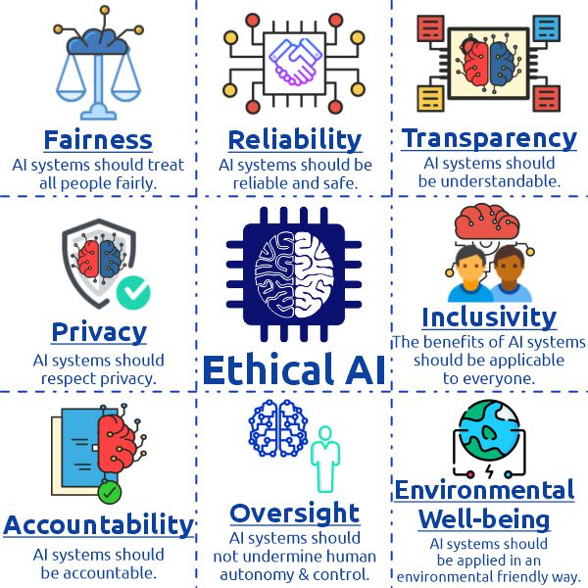
Introduction: The AI Landscape
From Hype to Practicality
The AI industry has moved beyond the initial excitement phase. Organizations now demand practical, reliable solutions that deliver measurable business value rather than impressive demos.
The Need for Reliable AI
Modern AI applications require robust workflows, consistent outcomes, and transparent processes. Reliability is no longer optional—it's essential for enterprise adoption.

Slide 3
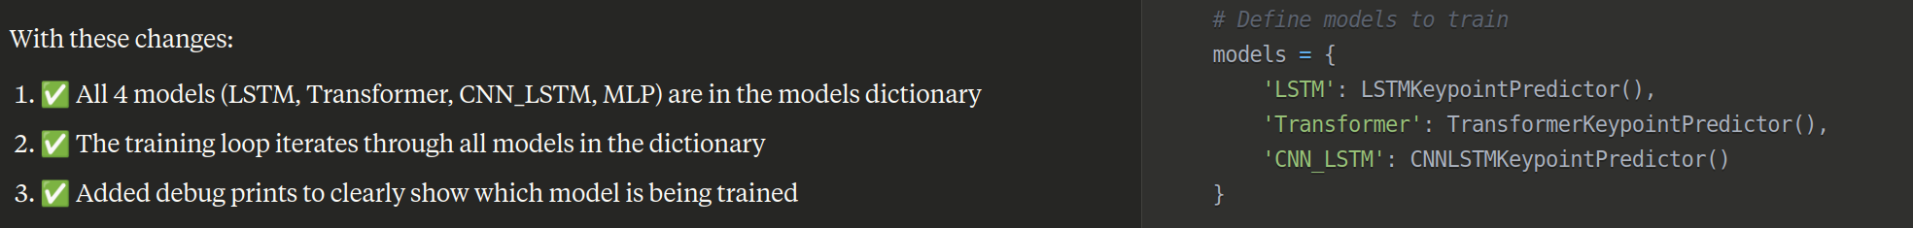

Slide 4





What is Reliable AI?
"Reliable AI systems consistently deliver accurate, predictable, and trustworthy results while maintaining transparency, safety, and robustness across diverse operating conditions."
Robustness
Interpretability
Performs consistently across different environments and edge cases
Provides clear explanations for decisions and outcomes
Safety
Accuracy
Operates within defined boundaries with fail-safe mechanisms
Encompasses fairness, accountability, and ethical considerations

Slide 5






The Evolution of AI: From Generative to Agentic
Generative AI
Agentic AI
Content creation and response generation
Autonomous action and goal-oriented execution
Generative AI
Agentic AI
• Responds to prompts
• Autonomous goal pursuit
• Creates content (text, images, code)
• Takes actions in environments
• Requires human direction
• Plans and executes strategies
• Passive interaction model
• Active interaction model
• Limited to generation tasks
• Comprehensive task execution

Slide 6




Agentic AI: Core Attributes
Intentionality
Autonomy
The ability to pursue specific goals and objectives, often derived from high-level directives or learned from environmental interactions.
The capacity to operate independently without continuous human intervention, making decisions and executing tasks based on internal models.
Example: An AI agent tasked with optimizing supply chain efficiency actively seeks solutions to reduce costs and improve delivery times.
Example: A trading agent that monitors markets, analyzes trends, and executes trades without requiring approval for each transaction.
Adaptivity
Self-Reflection
The ability to learn from experience and modify behavior to improve performance over time in changing conditions.
The capacity to monitor its own performance, evaluate actions, and identify areas for improvement through metacognitive processes.
Example: A customer service agent that learns from interactions to provide increasingly personalized and effective responses.
Example: A diagnostic AI that analyzes its prediction accuracy and adjusts its models to improve future diagnoses.

Slide 7





Agentic AI Architectures: Single-Agent
Overview
Single-agent architectures involve a solitary AI agent operating within an environment to accomplish specific, well-defined tasks without requiring coordination with other agents.
Key Characteristics
Autonomous operation within defined scope
Single Task
Simpler design and implementation
Direct environment interaction
Limited by individual capabilities
No collective intelligence benefits

Slide 8







Agentic AI Architectures: Multi-Agent
Multi-agent systems consist of multiple AI agents that interact and collaborate to achieve common goals through distributed problem-solving and coordinated actions.
Benefits
Coordination Challenges
Distributed problem-solving capabilities
Complex communication protocols
Parallel task execution
Conflict resolution mechanisms
Collective intelligence emergence
Synchronization overhead
Fault tolerance through redundancy
Emergent behavior unpredictability
Scalable resource allocation
Debugging and monitoring complexity

Slide 9















Agentic AI Architectures: Hierarchical (Vertical)
Hierarchical architectures organize agents in a tree-like structure with clear command chains, where higher-level agents coordinate and direct lower-level agents to achieve complex objectives.
Strategic Level
Advantages
Clear command and control structure
Efficient resource allocation
Tactical Level
Scalable coordination mechanisms
Predictable behavior patterns
Potential Rigidity
Operational Level
Single points of failure
Limited adaptability to change
Communication bottlenecks
Reduced innovation at lower levels

Slide 10





Agentic AI Architectures: Collaborative (Horizontal)
Collaborative architectures feature peer-to-peer agent interactions with decentralized control, where agents work together as equals to achieve shared objectives through consensus and cooperation.
Decentralized Control
Enhanced Flexibility
Collective Intelligence
No single point of failure, distributed decision-making authority
Adaptive responses to changing conditions and requirements
Emergent problem-solving through collaborative reasoning

Slide 11









Agentic AI Architectures: Hybrid
Hierarchical Structure
Collaborative Network
Strategic Planning
Tactical Coordination
Operational Execution
Hybrid Architecture Benefits
Superior Scalability
Enhanced Adaptability
Improved Robustness
Balanced Control
Flexible Coordination
Optimal Performance

Slide 12



Reliable Workflows: JSON Workflow-Based Tasks
{
"workflow_id"
:
"customer_onboarding"
,
"version"
:
"1.2.0"
,
"steps"
: [
{
"id"
:
"validate_input"
,
"type"
:
"validation"
,
"required_fields"
: [
"email"
,
"name"
],
"outcome_check"
: {
"schema"
:
"customer_schema.json"
,
"required"
:
true
}
},
{
"id"
: [
:
"create_account"
,
"type"
:
"api_call"
,
"depends_on"
"validate_input"
],
"endpoint"
:
"/api/accounts"
,
"outcome_check"
: {
"status_code"
:
201
,
"response_schema"
:
"account_response.json"
}
},
{
"id"
:
"send_welcome_email"
JSON workflows provide a structured, machine-readable format for defining complex AI tasks with clear dependencies, validation rules, and outcome checks at each step.
,
"type"
:
"notification"
,
"depends_on"
: [
"create_account"
],
"template"
:
"welcome_template"
,
"outcome_check"
: {
"delivery_status"
:
"sent"
,
"timeout"
:
30
}
}
]
}
Why JSON for AI Workflows?
Human-readable and machine-parseable
Schema validation for consistency
Easy integration with APIs
Version control and collaboration
Self-improvement and reliable execution

Slide 13






JSON Workflow: Step-by-Step Execution
1
2
3
4
Parse Workflow
Resolve Dependencies
Execute Tasks
Monitor & Report
Load and validate JSON workflow definition
Build execution graph based on task dependencies
Run tasks in dependency order with validation
Track progress and handle failures gracefully
Example: E-commerce Order Processing
validate_order
process_payment
Validate Order
Process Payment
Check inventory, pricing, and customer data
Charge customer and update financial records
update_inventory
ship_order
Update Inventory
Ship Order
Reduce stock levels and trigger reorder if needed
Generate shipping label and notify logistics
send_confirmation
complete_order
Send Confirmation
Complete Order
Email customer with order details and tracking
Mark order as fulfilled and update analytics

Slide 14











Outcome Checks at Each Step
Automated verification mechanisms ensure each workflow step produces expected results before proceeding, preventing cascading failures and maintaining system reliability.
Execute Step
Validate Output
Proceed or Retry
Perform the defined task or operation
Check results against expected criteria
Continue to next step or handle failure
Automated Verification
Semantic Validation
Schema validation
Content relevance
Data type checking
Logical consistency
Range validation
Business rule compliance
Format verification
Quality thresholds
Completeness checks
Context appropriateness

Slide 15








Implementing Outcome Checks
Example: Robust Outcome Check
{
"outcome_check"
: {
"validation_type"
:
"comprehensive"
,
"schema_validation"
: {
"schema_file"
:
"response_schema.json"
,
"required"
:
true
},
"semantic_checks"
: [
{
"type"
:
"content_relevance"
,
"threshold"
:
0.8
},
{
"type"
:
"sentiment_analysis"
,
"expected_range"
: [
-0.2
,
1.0
]
}
],
"business_rules"
: [
{
"rule"
:
"response_length_min"
,
"value"
:
50
: [
Technical Approaches
},
{
"rule"
:
"contains_required_fields"
,
"fields"
"status"
,
"data"
]
}
],
"timeout"
:
30
,
"retry_policy"
: {
"max_attempts"
:
3
,
"backoff_strategy"
:
"exponential"
},
"failure_handling"
: {
"action"
:
"rollback_and_alert"
Schema validation using JSON Schema
,
"notification_channels"
: [
"email"
,
"slack"
]
}
}
}
Custom validation functions
AI-powered semantic checks
Best Practices
Statistical anomaly detection
Define clear success criteria for each step
Business rule validation
Implement both syntactic and semantic validation
Use timeout mechanisms for long-running checks
Log validation results for debugging
Provide meaningful error messages
Enable graceful failure handling

Slide 16








Self-Improving Workflows and Tools
AI systems that continuously enhance their own capabilities through iterative learning, feedback analysis, and autonomous optimization of their workflows and tools.
Execute
Analyze
Learn
Improve
Iterative Feedback Loops
Open-Ended Exploration
Continuous collection and analysis of performance data to identify improvement opportunities and optimize system behavior.
Systematic exploration of new approaches and strategies to discover novel solutions and avoid local optimization traps.
Performance monitoring
Strategy diversification
Error pattern analysis
Novel approach testing
Success factor identification
Archive-based evolution
Automated adjustments
Parallel path exploration

Slide 17





Darwin Gödel Machine: A Paradigm
"A revolutionary approach where AI systems improve themselves by rewriting their own code, combining the theoretical insights of Gödel Machines with the empirical power of Darwinian evolution for continuous self-enhancement."
Self-Modifying Code
Performance Evaluation
Open-Ended Exploration
Reads and modifies its own Python codebase to improve performance
Tests proposed changes against coding benchmarks like SWE-bench
Maintains an archive of agents for parallel evolutionary paths
Breakthrough Results
20% → 50%
14.2% → 30.7%
SWE-bench Performance
Polyglot Benchmark
2.5x
Continuous
Improvement Factor
Self-Enhancement

Slide 18
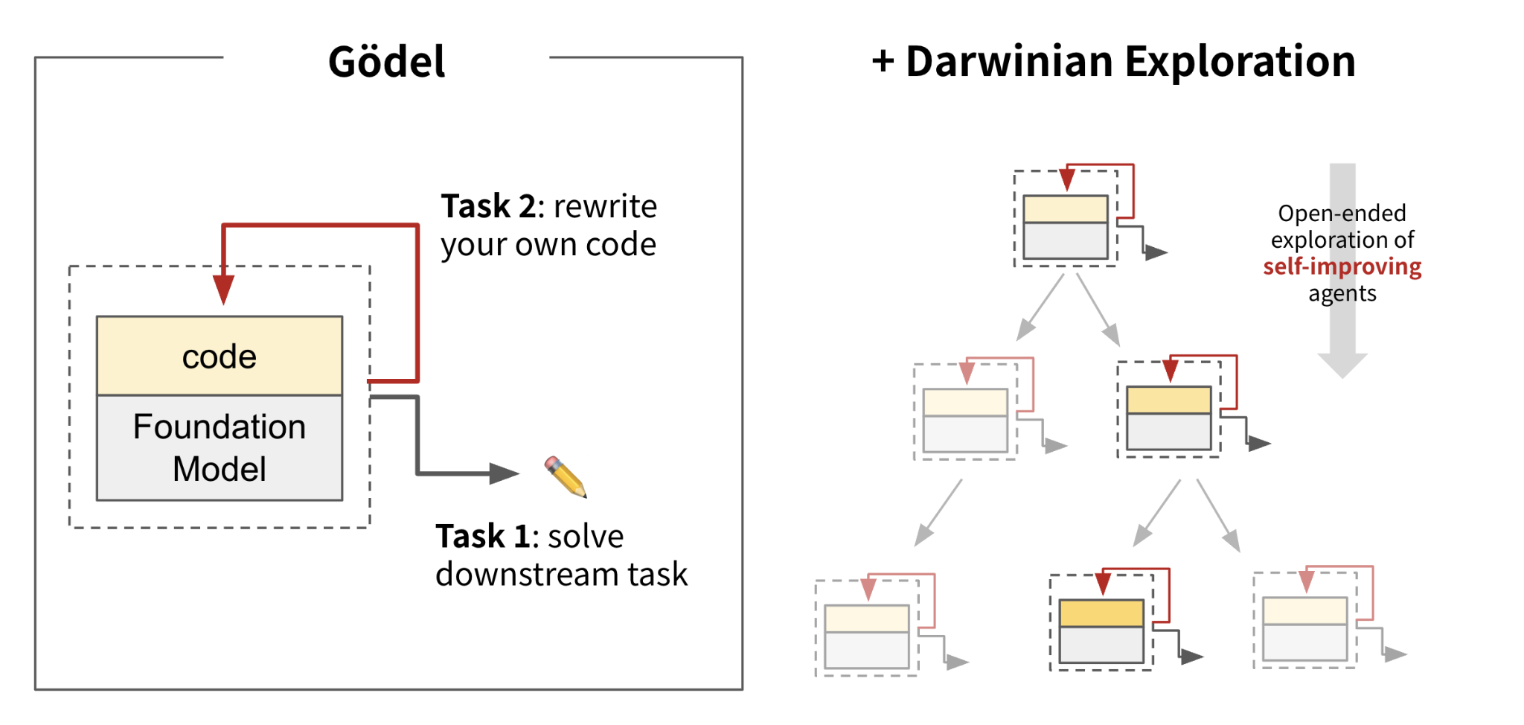
Darwin Gödel Machine: A Paradigm
"A revolutionary approach where AI systems improve themselves by rewriting their own code, combining the theoretical insights of Gödel Machines with the empirical power of Darwinian evolution for continuous self-enhancement."
Self-Modifying Code
Performance Evaluation
Open-Ended Exploration
Reads and modifies its own Python codebase to improve performance
Tests proposed changes against coding benchmarks like SWE-bench
Maintains an archive of agents for parallel evolutionary paths
Breakthrough Results
20% → 50%
14.2% → 30.7%
SWE-bench Performance
Polyglot Benchmark
2.5x
Continuous
Improvement Factor
Self-Enhancement

Slide 19
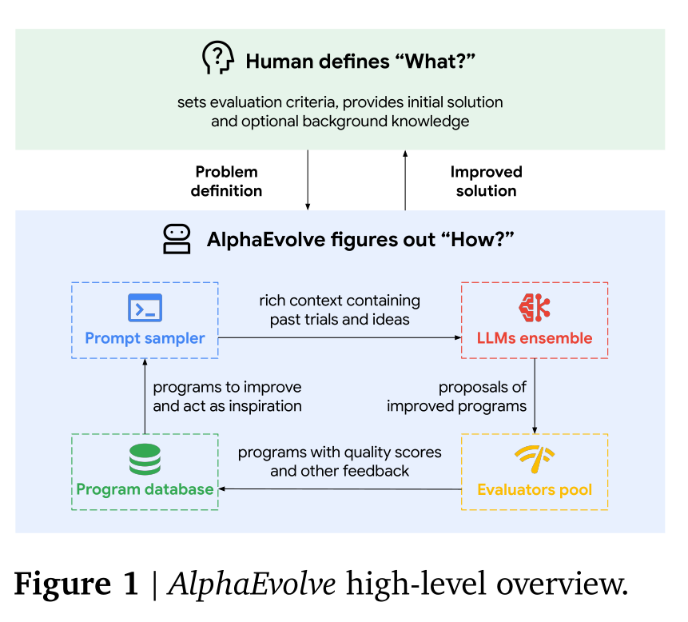
Alpha Evolve
Improvement Factor
Self-Enhancement

Slide 20









Mechanisms for Self-Improvement
Reinforcement Learning
Meta-Learning
Agents learn optimal behaviors through trial-and-error interactions with their environment, receiving rewards for successful actions.
"Learning to learn" approaches that enable rapid adaptation to new tasks by leveraging knowledge from previous learning experiences.
Key Features:
Key Features:
Reward-based optimization
Few-shot learning capabilities
Policy gradient methods
Transfer learning optimization
Experience replay mechanisms
Gradient-based meta-learning
Multi-agent coordination
Task distribution modeling
Evolutionary Algorithms
Neural Architecture Search
Population-based optimization methods that evolve solutions through selection, mutation, and crossover operations inspired by natural evolution.
Automated design of neural network architectures through systematic exploration of the architecture space to find optimal structures.
Key Features:
Key Features:
Population diversity maintenance
Automated architecture design
Multi-objective optimization
Differentiable architecture search
Genetic programming variants
Progressive architecture growth
Novelty search algorithms
Hardware-aware optimization

Slide 21







Website-as-an-API Concept
Transform any web application into a programmable API through browser automation, enabling AI agents to interact with websites as if they were traditional APIs.
Web Application
Browser Extension
API Server
AI Agent
Any website or web app
DOM manipulation layer
REST endpoint handler
Programmatic access
Automation Beyond APIs
Legacy Integration
Universal Access
Access any web functionality, even without official APIs
Connect modern AI systems with older web applications
Turn any human-accessible interface into machine-accessible

Slide 22







How Website-as-an-API Works
API Server
Browser Extension
Content Script
Response
Receives HTTP requests and publishes SSE events
Consumes events and orchestrates DOM manipulation
Performs actions through DOM manipulation
Returns results via callback URL
DOM Manipulation
Mimicking User Actions
Browser extensions inject content scripts that interact with web pages by manipulating the Document Object Model (DOM), simulating user actions like clicking, typing, and form submission.
The system programmatically replicates human interactions with web interfaces, including navigation, data entry, and complex multi-step workflows, making any web application accessible via API.
// Example: Clicking a button
const button = document.querySelector('button[aria-label="Submit"]');
button.click();
// Wait for elements to load
async function waitForElement(selector) {
return new Promise(resolve => {
const observer = new MutationObserver(() => {
const element = document.querySelector(selector);
if (element) {
observer.disconnect();
resolve(element);
}
});
observer.observe(document.body, { childList: true, subtree: true });
});
}
const input = document.querySelector('input[name="email"]');
input.value = 'user@example.com';
input.dispatchEvent(new Event('input', { bubbles: true }));
// Example: Filling a form field

Slide 23













Use Cases for Website-as-an-API
Data Extraction
Automated Form Filling
Legacy System Integration
Automatically extract structured data from websites that don't provide APIs, enabling systematic data collection.
Programmatically fill out web forms and submit applications, reducing manual data entry and human error.
Connect modern applications with older web-based systems that lack modern API interfaces.
Examples:
Examples:
Examples:
Price monitoring from e-commerce sites
Insurance claim submissions
ERP system automation
Job listings aggregation
Government permit applications
Banking portal integration
Real estate data collection
Bulk customer registrations
Healthcare system connectivity
Website Monitoring
Automated Testing
Workflow Automation
Monitor website changes, performance metrics, and availability through automated interactions.
Perform comprehensive testing of web applications through programmatic user interaction simulation.
Integrate web-based tasks into larger automated workflows and business process automation.
Examples:
Examples:
Examples:
Content change detection
End-to-end testing
Multi-platform data sync
Performance benchmarking
User journey validation
Cross-system notifications
Uptime monitoring
Regression testing
Automated reporting

Slide 24








Document Generation with AI
Template-Based
Rule-Based
AI-Powered
Intelligent
Static templates with variable substitution
Conditional logic and business rules
Dynamic content generation and adaptation
Context-aware, personalized documents
Automated Content Creation
Dynamic Adaptation
AI systems can generate comprehensive documents from minimal input, understanding context and requirements to produce relevant content.
Modern AI document generation adapts content based on audience, purpose, and real-time data, ensuring relevance and accuracy.
Key Capabilities:
Key Capabilities:
Natural language generation
Audience-specific customization
Multi-format output (PDF, Word, HTML)
Real-time data incorporation
Style and tone adaptation
Compliance and regulatory adherence
Data integration and visualization
Version control and tracking

Slide 25









AI Calling: Interacting with External Systems
Intelligent tool-calling enables AI agents to seamlessly interact with external APIs, databases, and services, extending their capabilities beyond internal processing.
AI Agent
Tool Selection
API Execution
Result Integration
Analyzes task and determines required tools
Chooses appropriate APIs and services
Makes calls with proper parameters
Processes and integrates responses
Intelligent Tool Calling
Seamless API Integration
Robust Error Handling
Automatically selects and invokes the most appropriate tools based on context and requirements
Handles authentication, rate limiting, and data formatting for diverse external services
Gracefully manages failures, retries, and fallback strategies for reliable operation

Slide 26





Advanced Technical Frameworks
Workflow Automation
Orchestration Platforms
Comprehensive frameworks for designing, executing, and monitoring complex multi-step workflows with intelligent decision-making capabilities.
Advanced orchestration systems that coordinate multiple AI agents, services, and resources to achieve complex objectives efficiently.
Key Features:
Key Features:
Visual workflow designers
Multi-agent coordination
Conditional branching logic
Resource allocation optimization
Error recovery mechanisms
Load balancing and scaling
Performance analytics
Service mesh integration
Human-in-the-loop integration
Distributed task scheduling
Real-time Responsiveness
Production Systems
High-performance frameworks designed for real-time processing and immediate response to dynamic events and changing conditions.
Enterprise-grade frameworks with robust monitoring, security, and scalability features for mission-critical AI deployments.
Key Features:
Key Features:
Comprehensive monitoring and alerting
Low-latency processing pipelines
Security and compliance controls
Event-driven architectures
Auto-scaling and load management
Stream processing capabilities
Disaster recovery mechanisms
Predictive pre-processing
Audit trails and governance
Edge computing integration

Slide 27





Foundational Models and Their Evolution
Text-Only Models
Vision Integration
Audio Processing
Multimodal AI
Language understanding and generation
Image understanding and analysis
Speech and sound recognition
Unified understanding across modalities
Multimodal Perception Systems
Predictive Analytics Capabilities
Advanced AI systems that can simultaneously process and understand multiple types of input including text, images, audio, and video for comprehensive scene understanding.
Sophisticated forecasting and prediction systems that leverage historical data, real-time inputs, and advanced modeling to anticipate future trends and outcomes.
Key Capabilities:
Key Capabilities:
Cross-modal reasoning and inference
Time series forecasting
Real-time multimodal processing
Anomaly detection and alerting
Context-aware interpretation
Scenario modeling and simulation
Unified representation learning
Uncertainty quantification

Slide 28









Adaptive Reasoning and Learning
Continuous improvement through reinforcement learning and adaptive mechanisms enables AI systems to evolve their reasoning capabilities and optimize performance over time.
Observe
Learn
Reason
Act
Reinforcement Learning
Adaptive Mechanisms
AI agents learn optimal strategies through trial-and-error interactions, receiving feedback signals that guide behavior improvement and decision-making refinement.
Dynamic adjustment systems that modify AI behavior, parameters, and strategies in response to changing environments and performance feedback.
Key Mechanisms:
Key Mechanisms:
Reward signal optimization
Dynamic parameter tuning
Policy gradient methods
Context-aware adaptation
Value function approximation
Online learning algorithms
Multi-agent learning protocols
Feedback loop optimization

Slide 29



Computational Efficiency and Scalability
Hardware Innovations
Software Optimizations
Specialized hardware architectures and accelerators designed to optimize AI workloads for maximum performance and energy efficiency.
Advanced algorithms and software techniques that reduce computational complexity and improve resource utilization for scalable AI deployment.
Key Innovations:
Key Innovations:
GPU and TPU acceleration
Model compression and pruning
Neuromorphic computing chips
Quantization techniques
Edge computing processors
Distributed training algorithms
Quantum computing integration
Efficient attention mechanisms
Memory-compute integration
Dynamic resource allocation
Real-World Deployment Metrics
10,000x
90%
100ms
99.9%
Throughput Improvement
Energy Reduction
Latency Target
Availability SLA

Slide 30

















Industry Applications of Reliable AI
Healthcare
Finance
Manufacturing
Autonomous surgical robots
Fraud detection systems
Production optimization
AI-powered diagnostics
Algorithmic trading
Predictive maintenance
Personalized treatment plans
Risk management
Quality control
Drug discovery acceleration
Regulatory compliance
Supply chain management
Customer Service
Transportation
Smart Cities
Intelligent chatbots
Autonomous vehicles
Energy optimization
Virtual assistants
Traffic optimization
Waste management
Personalized support
Route planning
Public safety
Sentiment analysis
Fleet management
Urban planning

Slide 31










Challenges in Reliable AI
Scalability Constraints
Real-time Adaptability
Scaling AI systems to handle vast amounts of data and complex tasks while maintaining performance and resource efficiency.
Achieving instant adaptation to dynamic environments and unforeseen changes without compromising reliability.
Key Impacts:
Key Impacts:
Performance degradation at scale
Delayed response to changes
Resource consumption increases
Reduced system agility
Infrastructure complexity
Critical application limitations
Integration Complexities
Robustness & Fault-Tolerance
Seamlessly integrating AI systems with existing legacy infrastructure and diverse external platforms.
Ensuring AI systems can handle failures gracefully and maintain operation in critical applications.
Key Impacts:
Key Impacts:
Interoperability issues
System failures in critical scenarios
Custom development overhead
Lack of graceful degradation
Data exchange challenges
Safety concerns
Transparency & Interpretability
Making AI decision-making processes transparent and explainable, especially in regulated industries where accountability is crucial.
Key Impacts:
Black-box decision making
Regulatory compliance issues
Reduced trust and adoption
Difficulty in debugging and improvement

Slide 32





Ethical Considerations
Bias and Fairness
Privacy and Data Security
Ensuring AI systems treat all individuals and groups fairly, without discrimination based on protected characteristics or historical biases in training data.
Protecting individual privacy rights and securing sensitive data throughout the AI lifecycle, from collection to processing and storage.
Key Concerns:
Key Concerns:
Algorithmic discrimination
Unauthorized data collection
Historical bias amplification
Data breaches and leaks
Representation gaps in data
Inference attacks on models
Unequal access to benefits
Consent and data ownership
Transparency and Explainability
Accountability and Responsibility
Making AI decision-making processes understandable and explainable to users, stakeholders, and regulatory bodies for accountability and trust.
Establishing clear lines of responsibility for AI system outcomes and ensuring mechanisms exist for redress when systems cause harm.
Key Concerns:
Key Concerns:
Black-box decision making
Unclear liability frameworks
Lack of interpretability
Diffused responsibility chains
Insufficient documentation
Inadequate oversight mechanisms
Complex model architectures
Limited recourse for harm

Slide 33





Governance and Societal Impact
Regulatory Frameworks
Employment and Workforce
Developing comprehensive legal and regulatory frameworks to govern AI development, deployment, and use while balancing innovation with safety and rights protection.
Addressing the transformative impact of AI on employment, skills requirements, and workforce development to ensure inclusive economic benefits.
Key Considerations:
Key Considerations:
Cross-border regulatory harmonization
Job displacement and creation patterns
Industry-specific compliance requirements
Reskilling and upskilling programs
Liability and accountability frameworks
Social safety net adaptations
Certification and auditing standards
Human-AI collaboration models
Innovation-friendly policy design
Economic inequality mitigation
Policy Development Framework
1
2
3
4
Assessment
Stakeholder Engagement
Policy Design
Implementation
Evaluate AI impact and risks
Consult industry and civil society
Develop balanced regulations
Deploy and monitor effectiveness

Slide 34







Future Directions and Recommendations
Advanced Architectural Innovation
Enhanced Real-time Adaptability
Develop more sophisticated and flexible architectural designs, particularly hybrid models that seamlessly integrate diverse capabilities.
Improve real-time adaptability to enable instantaneous responses to dynamic changes and unforeseen events.
Key Priorities:
Key Priorities:
Low-latency processing
Novel multi-agent coordination
Predictive modeling
Hierarchical control mechanisms
Adaptive control mechanisms
Dynamic architecture adaptation
Ethical and Explainable Frameworks
Computational Scalability
Create methods for ensuring fairness, mitigating bias, and providing transparent explanations for AI decisions.
Enhance computational scalability to handle increasingly large datasets and complex tasks efficiently.
Key Priorities:
Key Priorities:
Bias detection and mitigation
Distributed computing frameworks
Explainable AI methods
Hardware acceleration
Ethical decision frameworks
Algorithm optimization
Robustness and Reliability
Emerging Technology Integration
Improve robustness and reliability, particularly in safety-critical applications with advanced fault-tolerance.
Explore integration with quantum computing, blockchain, and advanced robotics to unlock new capabilities.
Key Priorities:
Key Priorities:
Fault-tolerance mechanisms
Quantum-AI convergence
Formal verification methods
Blockchain integration
Robust testing protocols
Advanced robotics fusion

Slide 35





Conclusion: The Path to Reliable AI Outcomes
From Hype to Reality
Agentic AI Revolution
AI has evolved from impressive demos to practical, reliable systems that deliver measurable business value through structured workflows and outcome validation.
The shift to autonomous, goal-oriented AI systems represents a fundamental transformation in how we approach artificial intelligence applications.
Reliability is Essential
Innovation Continues
Modern AI applications require robust workflows, consistent outcomes, and transparent processes for enterprise adoption and trust.
Self-improving systems, website-as-API concepts, and advanced orchestration are pushing the boundaries of what's possible.
The Future of AI Workflows
"As we move forward, the focus will be on creating AI systems that are not just intelligent, but reliable, transparent, and beneficial to society. The journey from hype to workflows is just the beginning."

